Slide 1

R&D PROJECT EVALUATION
Academic Year: 2024-25
Project ID: 33
Host-Based Intrusion Detection System: A Hybrid Approach
Submitted By:
Aryan Vats (BT22GCS208)
Shikhar Sharma (BT22GCS101)
Nitesh Jha (BT22GCS193)
Supervisor: Dr. Anand Kumar Mishra

Slide 2

Content
Introduction
Literature Review
Problem Statement
Objective
Methodology
Timeline
References

Slide 3
Introduction
HOST-BASED INTRUSION DETECTION SYSTEMS
The goal is to develop a system that:
•Monitors system activities on a system.
•Analyzes system call patterns to differentiate between normal and malicious behavior.
•Detects potential intrusions early to enhance security and minimize damage from cyberattacks.

Slide 4
Introduction
System call analysis
•System calls are the interface between a program and the operating system (OS).
•When a program needs to perform a task that requires OS resources (e.g., reading a file, allocating memory, or accessing hardware), it makes a system call.
Why are system calls important?
•Normal vs. Malicious Behavior: Different types of programs generate distinct patterns of system calls.
•Monitoring these patterns can help detect anomalies and identify potential intrusions.

Slide 5
Literature Review
Research Paper | Findings | Limitations | Main Components
[1] Semantic Approach to HIDS (G. Creech & J. Hu)
Introduced semantic analysis of system call patterns (contiguous & discontiguous) for anomaly detection.
High false positives, struggles with complex multi-step attacks.
System call sequences, semantic analysis, anomaly detection.
Limited to Linux, requires large labeled datasets, lacks adaptability to evolving attacks.
[2] Early Detection of Host-Based Intrusions in Linux (X. Zhang, Q. Niyaz, F. Jahan, W. Sun)
Proposed early detection of Linux intrusions using behavior analysis of system calls.
System call monitoring, anomaly detection, machine learning models.

Slide 6
Literature Review
Research Paper | Findings | Limitations | Main Components
[3] Stacking ensemble-based HIDS framework for detecting anomalous system processes in Windows OS using multiple word embedding
Used stacking ensemble with multiple word embeddings for anomaly detection, improving accuracy.
Computationally expensive, limited to Windows, may not generalize to new attack types.
Stacking ensemble, word embeddings (word2vec, GloVe), supervised learning.
Misses low-frequency attacks, lacks real-time deployment, struggles with zero-day attacks.
TF-IDF + SVD improved feature extraction and reduced dimensions for intrusion detection.
TF-IDF, SVD for dimensionality reduction, ML classifiers (SVM, Decision Tree, MLP).
[4] A TF-IDF Vectorizer and Singular Value Decomposition (SVD) based HIDS framework

Slide 7
Literature Review
Research Paper | Findings | Limitations | Main Components
[5] Evaluation of HIDS Using ADFA-SAA (B. Liu, S. Zhang, J. Chen)
Benchmarked HIDS performance on ADFA-SAA dataset, highlighting ML-based vs rule-based methods.
Dataset limitations, challenges in real-world deployment.
ADFA-SAA dataset, ML classifiers, performance evaluation.
[6] Comparative Study of ML Models on ADFA-SAA (L. Zhang, X. Liu, D. Wang)
Compared multiple ML models for intrusion detection, identifying strengths/weaknesses.
Limited generalization beyond ADFA-SAA, lacks hybrid model exploration.
ADFA-SAA dataset, ML models (SVM, RF, NN), accuracy benchmarking.

Slide 8
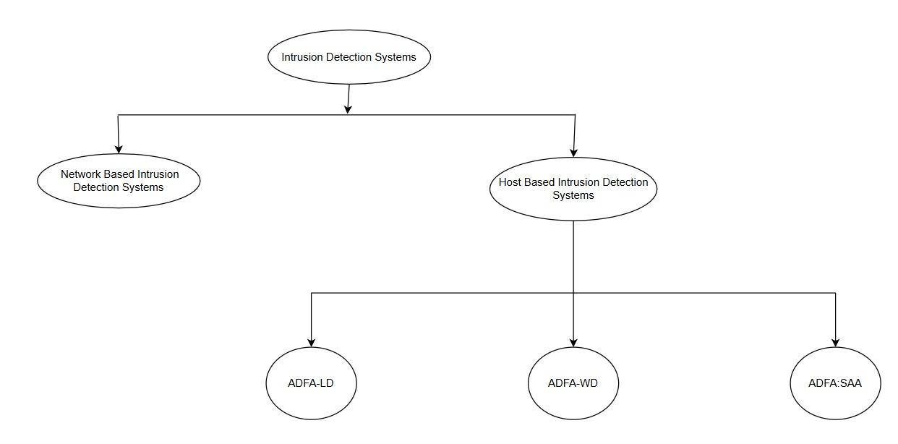
Taxonomy

Slide 9
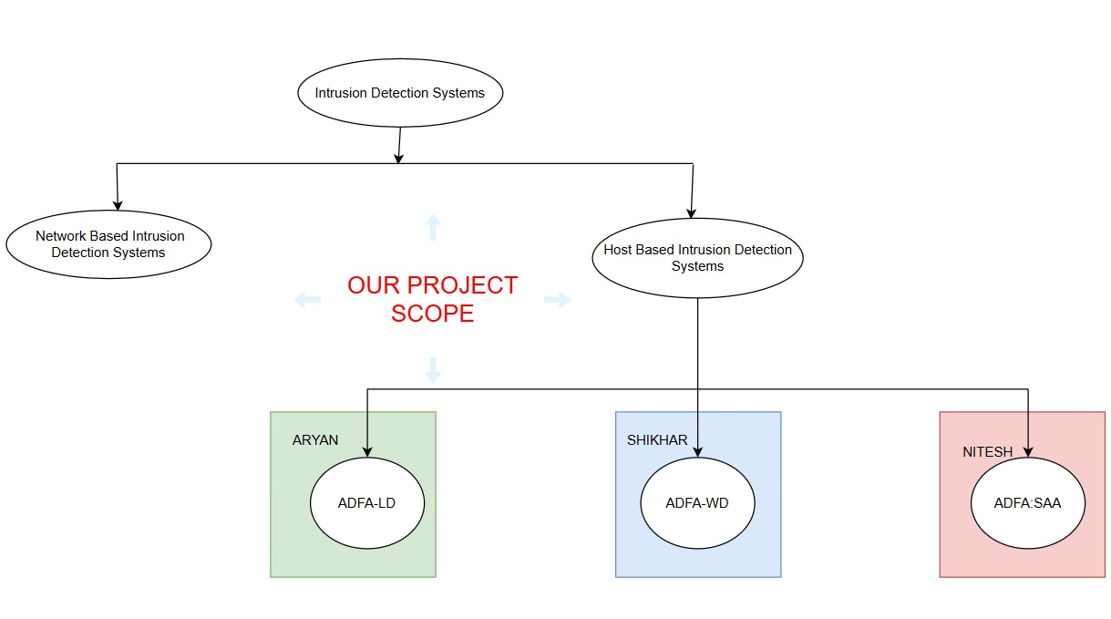
Taxonomy

Slide 10
Research Challenges
Data Collection and Labeling: Collecting large and diverse datasets of system calls under both normal and attack conditions is difficult.
Feature Extraction: Choosing the right features (e.g., unigrams, bigrams, contiguous, and discontiguous patterns) is complex.
Handling False Positives and Negatives: Striking a balance between sensitivity (catching true attacks) and specificity (avoiding false alarms) is hard

Slide 11
Problem Statement
Traditional security mechanisms struggle to detect sophisticated cyberattacks. Existing Host-Based Intrusion Detection Systems (HIDS) have high false positives and negatives.

Slide 12
Objective
To develop a hybrid Host-Based Intrusion Detection System (HIDS) that combines early anomaly detection with semantic pattern analysis using machine learning models (Random Forest, SVM, Naïve Bayes). The goal is to achieve high accuracy and real-time detection capabilities while maintaining computational efficiency in the Systems.

Slide 13
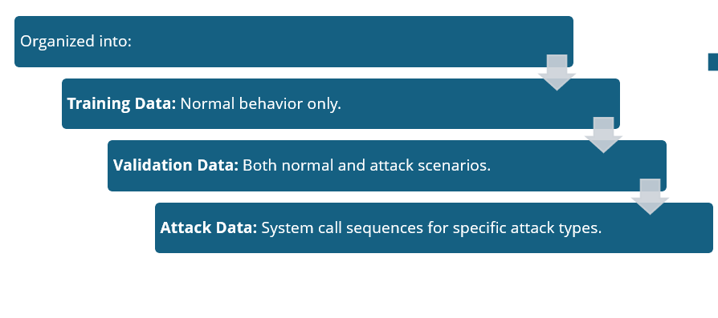
Initial Research
ADFA-LD datasets
•The ADFA-LD (Australian Defence Force Academy Linux Dataset) is a benchmark dataset for evaluating Host-based Intrusion Detection Systems (HIDS).
•Contains system call traces collected during normal operations and various attack scenarios on a Linux environment.

Slide 14
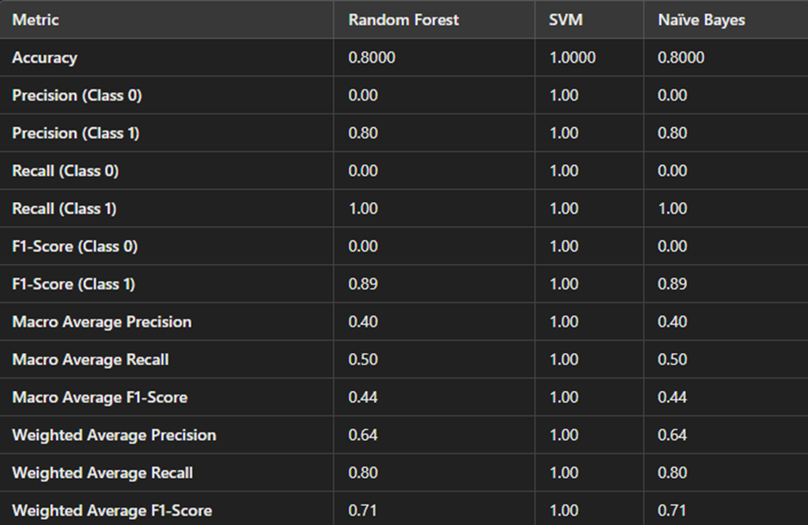
Initial Research
Application
(ADFA-LD datasets)

Slide 15
Initial Research
ADFA-WD datasets
The ADFA-WD (Australian Defence Force Academy Windows Dataset) is a widely known dataset for evaluating Host-based Intrusion Detection Systems (HIDS) on Windows systems.
It includes System calls and process activity logs collected from normal operations and various cyber attack scenarios.

Slide 16
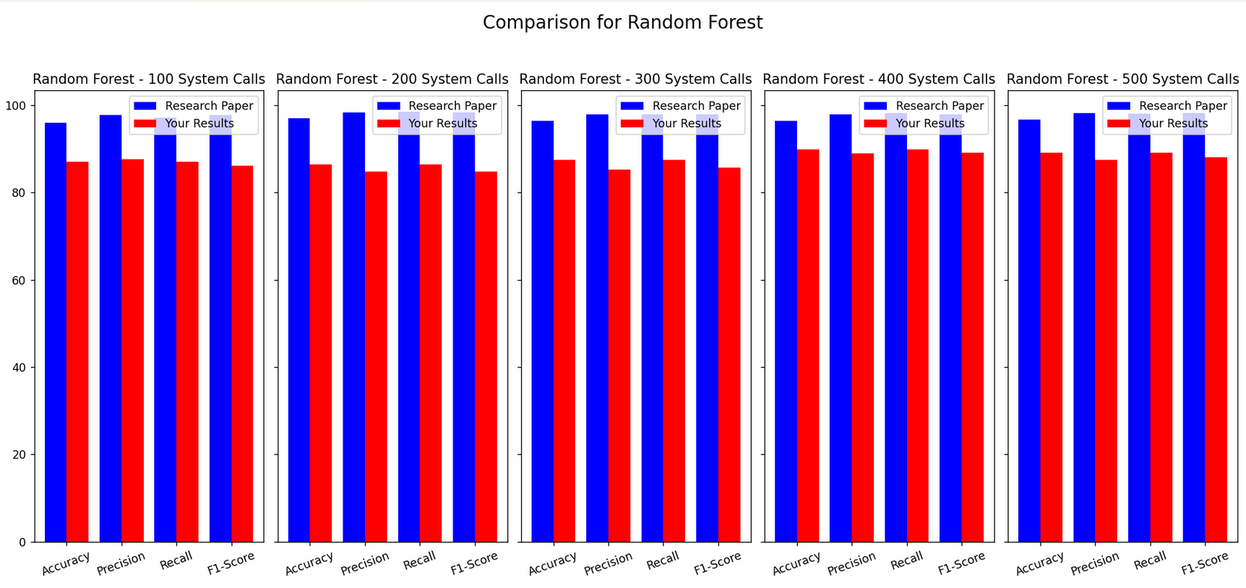
Initial Research
Application
(ADFA-WD datasets)

Slide 17
Initial Research
ADFA-SAA
A modern Host-Based Intrusion Detection System (HIDS) dataset.
Contains system call traces from normal and attack scenarios.
Used to evaluate machine learning-based intrusion detection models.

Slide 18

Initial Research
Application of ADFA-SAA
Using machine learning to classify normal vs. malicious system calls.
Reducing false positives/negatives for better security.
Improving real-time attack detection for HIDS.
Used to train and evaluate Host-Based Intrusion Detection Systems (HIDS) for detecting malicious system call behaviors in real-world cyberattacks.

Slide 19
Dataset Composition
Raw_Data,Limited_Horizon_Process_Traces,Full_Process_Traces
3 folders and then each folder contain S1,S2,S3 and S4
and then there are many files.
Why is ADFA - SAA important
Realistic attack scenarios for better model training.
More complex than older datasets, improving detection accuracy.
Helps in identifying zero-day and evolving cyberattacks.

Slide 20
Methodology
•Data Preprocessing: Extracted system call sequences from text files.
•Model Training: Used the normal samples from the TRAINING folder.
•Model Testing: Validated against both normal and attack samples from the VALIDATE folder.
•Evaluation Metrics: Accuracy, precision, recall, and F1-score to assess the model's performance.

Slide 21


Slide 22
References:
[1] G. Creech and J. Hu. A Semantic Approach to Host-based Intrusion Detection Systems Using Contiguous and Discontiguous System Call Patterns. Computers, IEEE Transactions on, PP(99):11, 2013.
[2] Early Detection of Host-based Intrusions in Linux Environment Xinrun Zhang∗, Quamar Niyaz, Farha Jahan, Weiqing Sun ECE Department, College of Engineering and Sciences Purdue University Northwest, Hammond, IN 46323, USA College of Engineering, The University of Toledo, OH 43607, USA
[3] Kumar, Yogendra, and Basant Subba. "Stacking ensemble-based HIDS framework for detecting anomalous system processes in windows based operating systems using multiple word embedding." Computers & Security 125 (2023): 102961.
[4] Subba, Basant, and Prakriti Gupta. "A tfidfvectorizer and singular value decomposition based host intrusion detection system framework for detecting anomalous system processes." Mohammad R. Aziz, Ali Saeed Alfoudi; Different mechanisms of machine learning and optimization algorithms utilized in intrusion detection systems. AIP Conf. Proc. 29 September 2023; 2839 (1): 040005. https://doi.org/10.1063/5.0171965
[5] A Comparative Study of Machine Learning Models on ADFA-SAA Dataset"Authors: L. Zhang, X. Liu, and D. Wang
[6] Evaluation of Host-based Intrusion Detection Systems using the ADFA-SAA Dataset"Authors: B. Liu, S. Zhang, and J. Chen

